Slide 1

DriverPass System Analysis
Bradley Brennand
Notes:
[No speaker notes required for this slide.]

Slide 2

System Requirements
Functional Requirements-
The system shall verify User credentials when attempting to login to the system.
The system shall link with the DriverPass database.
The system shall be linked with the DMV for updated resources.
Non-Functional Requirements
The system should be cloud based for database access and storage.
The system should react to user inquiries within two seconds.
The system should be updated weekly to keep up with technological advances.
Notes:
Here we have the functional and non-functional requirements. There will be a verification process for every user that uses the system. That system will be linked to a customer database that stores user information. The DMV will send notifications to admin users upon updates to their system and any information that changes. This allows the admins to schedule updates to the driverpass system and allows them to stay informed of key information. The driverpass system will be cloud based making system access and storage much easier for the users. The system will be checked and tested weekly for updates and security protocols. The response time of the driverpass system will be two seconds or less.

Slide 3
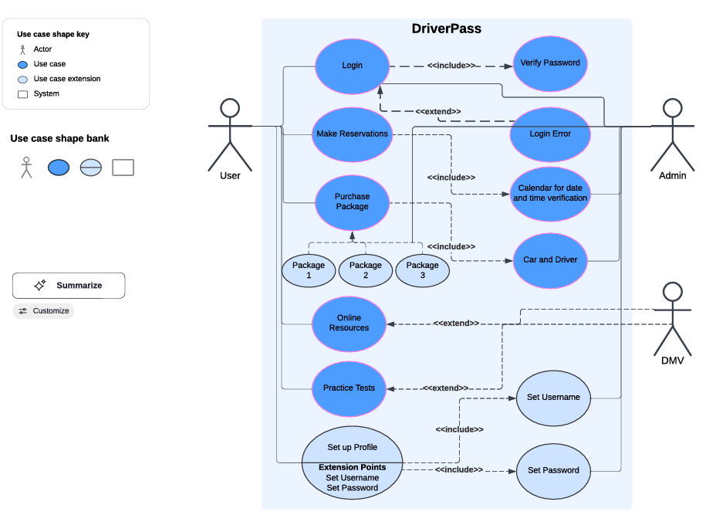
Use Case Diagram
Notes:
This is a Use Case diagram explaining the basic user and administrator roles of the DriverPass system. The Users will have basic access to the system allowing them to Login or create an account, make reservations, purchase driver packages, take practice tests, and access learning material provided from the Department of Motor Vehicle or DMV for short. The DriverPass system will have Administrators that will be able to monitor the system, modify the system such as appointments, be able to enable or disable different driver packages the users can choose. They will also be able to adjust appointment dates and times, address login credentials as needed and adjust access levels for specific users. The DMV will provide the admins and the system with up to date material and notify the admins of any updates that have been made to any material.

Slide 4
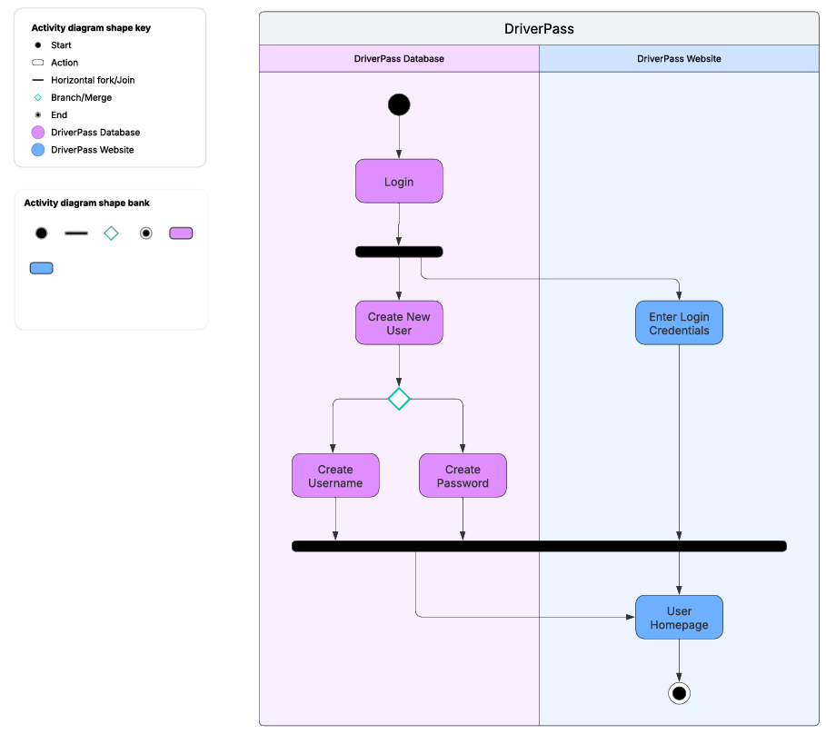
Activity Diagram
Notes:
This is one of the activity diagrams created to show how a user can login to use the DriverPass system. Starting from the login page there will be an option for the user to register as a new user or enter login credentials as an existing user which would then take the users to their own specific user homepage.

Slide 5
Security
Admins should have full access to system and login with username and password.
Internal users should have a broad access to update, modify, and delete information of users. Logging in with username and password.
Regular users should have basic access to the system to register and update or modify appointments and information as necessary. Login with username and password.
Each user will have their own username and password specific to them and managed via Driverpass system to ensure no duplicates.
The system will be able to have a forgot username or forgot password link on the login page.
The system will lock a users account after three unsuccessful attempts to login.
The admin and internal users will be notified of locked accounts.
The users will be notified of locked accounts and be required to verify identity before admins or internal users are able to unlock accounts.
The system should have proper security measures in place to ensure privacy and security for all users.
The system should notify Admin of an malicious activity noted on the system
Notes:
Looking at all aspects of the DriverPass system and knowing what the system should do, we put together some key features that the design phase should incorporate into the system to ensure proper system security for not only the users but the system itself. All users will have different login credentials that will be verified through a verification process. Each user will be set up with specific roles in the system to provide basic to full access of the system. Any attempted modification of the system shall be documented and recorded for follow up purposes. Notifications will be set up to notify users of attempted logins.

Slide 6
System Limitations
Compatibility with certain web browsers could limit functionality.
The one quarter time frame could be tight due to lack of people on the project.
Notes:
The system limitations to work around consist of system compatibility. For example, the DMV system may not be compatible as the DMV may not have the most up to date system. We need to keep this in mind when designing the system to ensure proper compatibility measures are taken.
Next, we have our time frame, due to limited staff having only four months to complete this project may be too short. Extending the deadline by a couple months could ensure the system is not rushed through the design and testing phases allowing a fully functional system to be delivered in a proper working and well tested manner.

